Slide 1


Capstone 2021

Slide 2
We are Arctic Thread
Team Members
Liam De Rivers
Mark Moerkerken
Seth VanNiekerk
Advisor
Hetal Shah

Slide 3
We are all enrolled in the Computer Programmer and Analyst program at Conestoga College
Founded in 2021, as a re-formation of the former ‘Desert broccoli’ group
Offering a new service to be introduced next ...

Slide 4
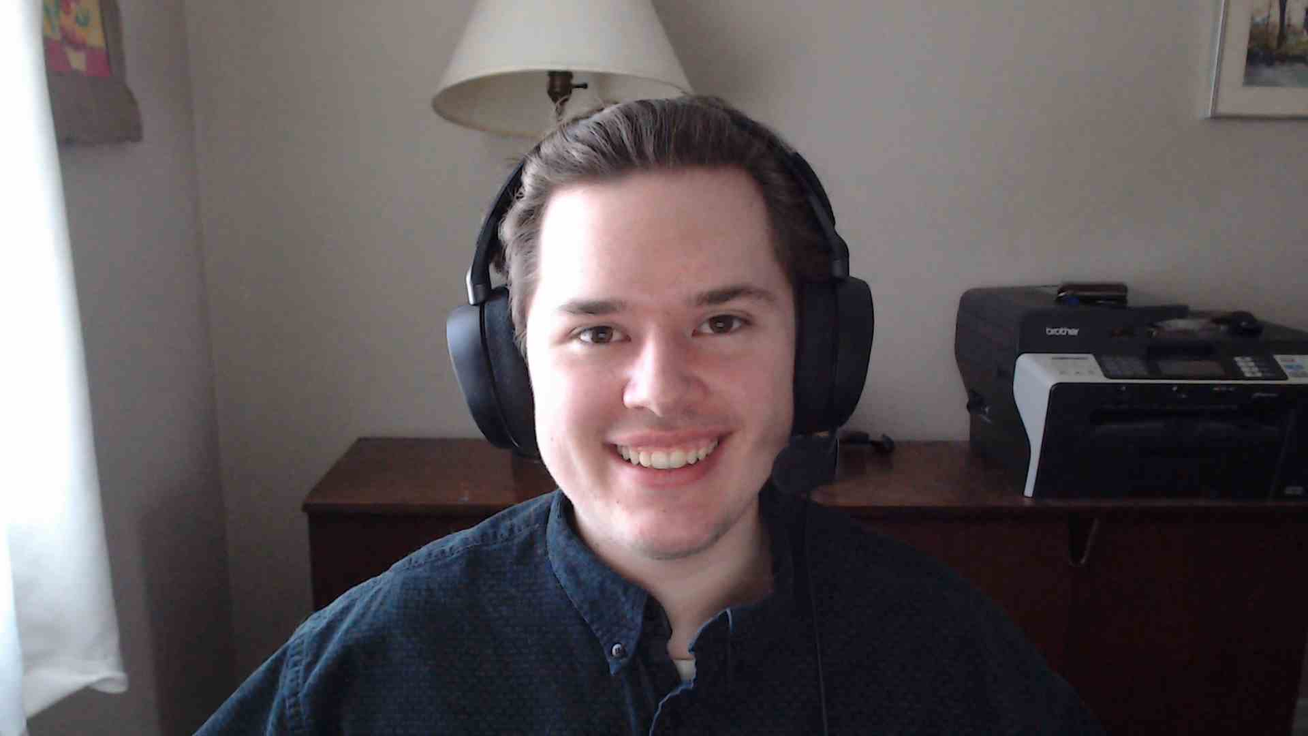

Liam De Rivers - Project Management

Slide 5
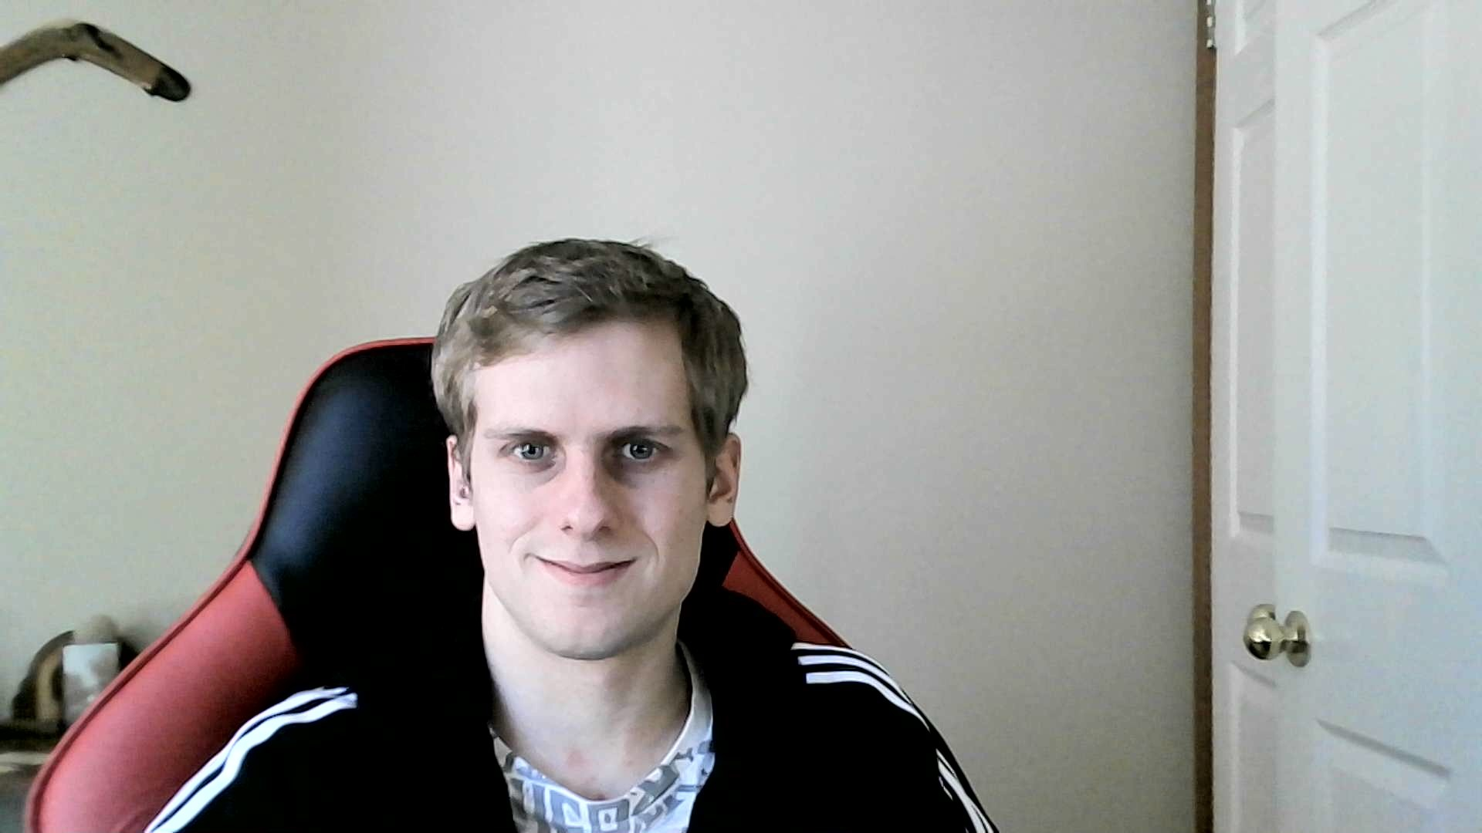
Mark Moerkerken - Frontend Development

Slide 6
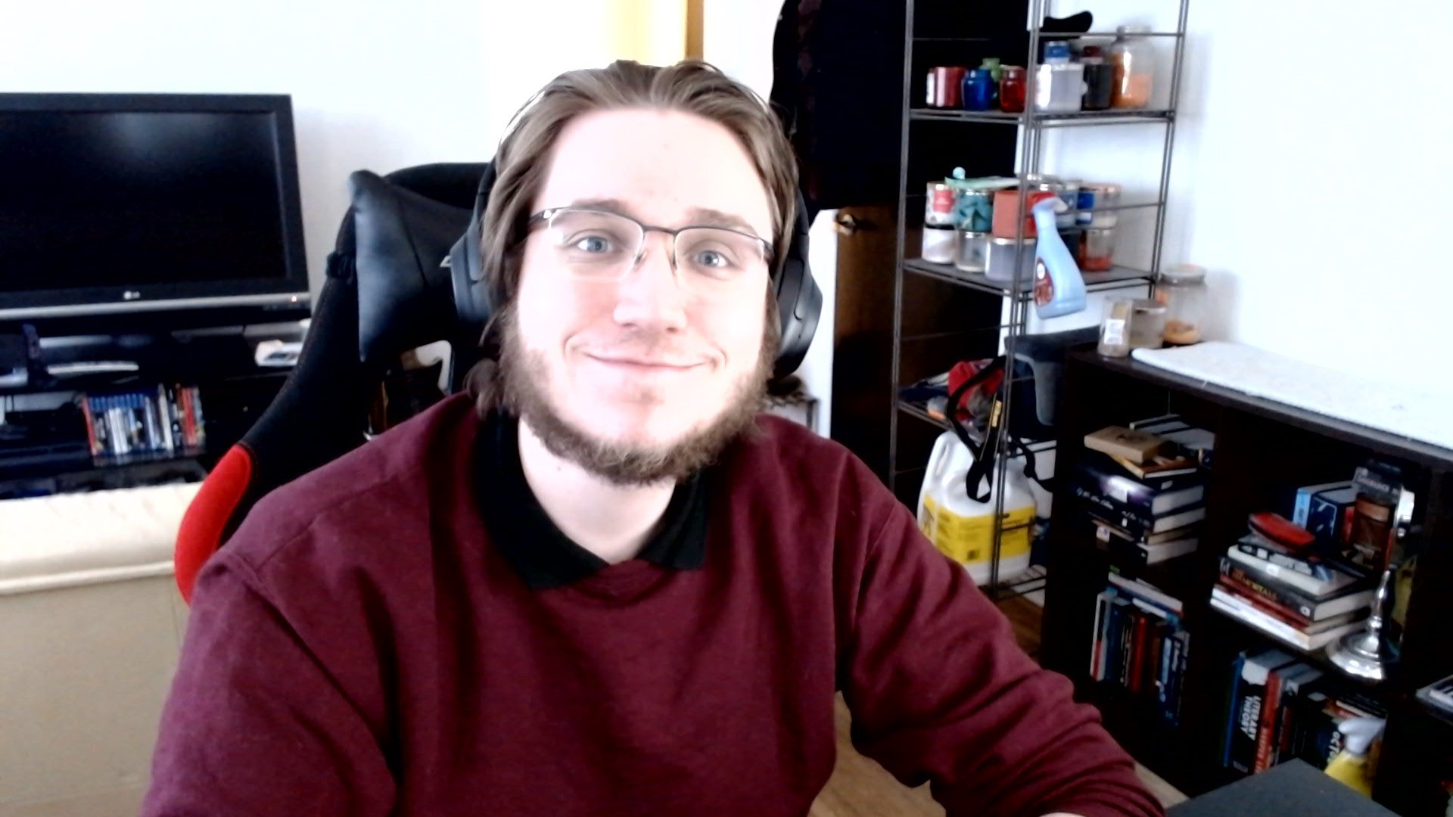
Seth VanNiekerk - Backend Development

Slide 7

Introducing KurbSide
An entrepreneurial project by Arctic Thread
End-to-End ‘curbside pickup’ platform
Unified website for vendors and customers
Robust branding options and customization

Slide 8



Built on the Microsoft Azure Stack
.NET Core 3.1
MSSQL/TSQL
IIS Web Services

